Slide 1
Introduction to Exploring K-T Extinction Patterns

Slide 2
Background vs. Mass Extinction
Background extinction and mass extinction
Mass Extinctions
Background extinction = species gradually and continuously go extinct, creating a turnover of species through time.
20
Extinction Rate
(famlies per million years)
Background Extinctions
0
600
400
200
0
Millions of Years Ago
Graph from University of California Museum of Paleontology's Understanding Evolution (http://evolution.berkeley.edu)
Notes:
For any one species, extinction may seem catastrophic. But over the grand sweep of life on Earth, extinction is business as usual. Extinctions occur continually, generating a "turnover" of the species living on Earth. This normal process is called background extinction.

Slide 3
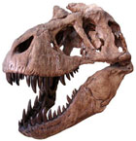
Background vs. Mass Extinction
Background extinction and mass extinction
Mass extinction = large number of species go extinct over a short period of time
Mass Extinctions
20
Extinction Rate
(famlies per million years)
Background Extinctions
0
600
400
200
0
Millions of Years Ago
T rex and graph from http://evolution.berkeley.edu
Notes:
Sometimes, however, extinction rates rise suddenly for a relatively short time — an event known as a mass extinction. Mass extinctions kill off many species, but the empty niches left behind may allow other lineages to radiate into new roles, shaping the diversification of life on Earth.
(CLICK) Earth’s most recent mass extinction occurred ~65 million years ago during the Cretaceous-Tertiary (KT) boundary when non-avian dinosaurs went extinct. But it wasn’t just the dinosaurs. Many other species – like marine organisms – also experienced high rates of extinction. In this lab, we’ll be studying how the K-T extinction event affected marine mollusks.
Given the number of species currently threatened with extinction most scientists agree we are close to entering another mass extinction event. (Click)

Slide 4
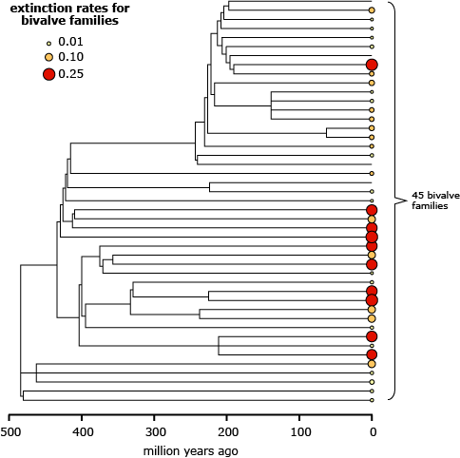
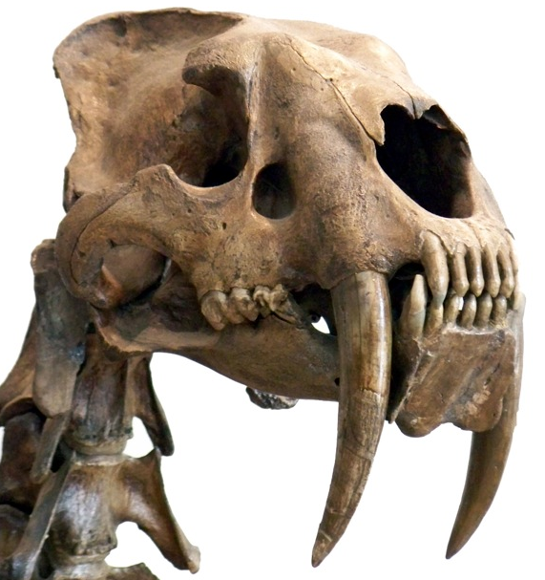
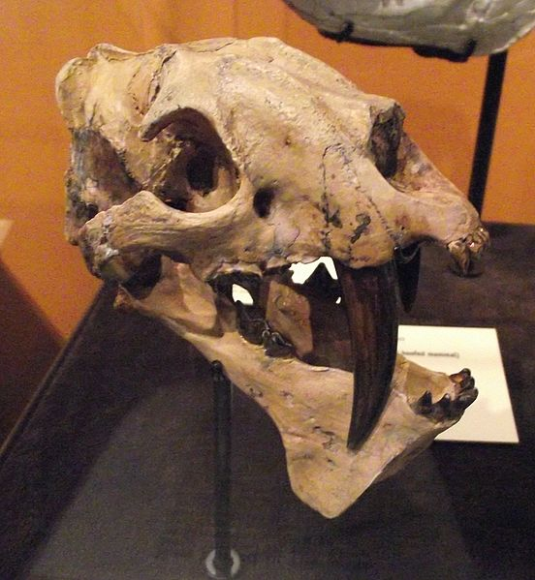
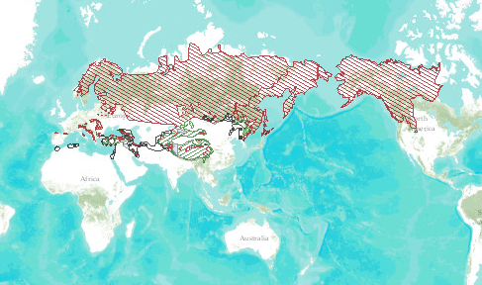
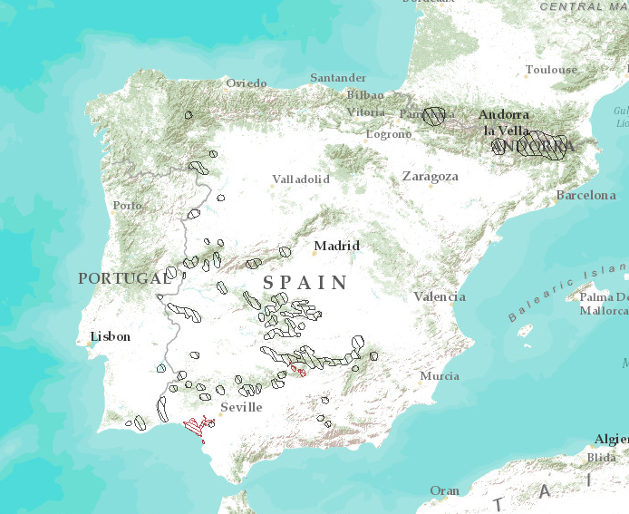
Extinction is non-random
Non-random extinctions
Certain traits may predispose species to extinction or survival
Diet
Geographic range
Some traits may only be important under certain threatening processes
Extinction selectivity can lead to extinction risk being clustered within families or genera as closely related species tend to inherit similar traits from their common ancestor.
Brown bear -
low risk of extinction
Iberian lynx -
critical risk of extinction
Smilodon, a felid (2.5 million -10,000 years ago)
Eusmilus, a nimravid (37.2 - 28.4 million years ago)
Maps from www.iucnredlist.org, Smilodon photo by Wallace63 at http://commons.wikimedia.org/wiki/File%3ASmilodon_head.jpg, Eusmilus photo by Stickpen at http://commons.wikimedia.org/wiki/File%3AEusmilusskull.jpg, Chiru photo by yun dan http://www.flickr.com/photos/yongzhong/4405796270/
Notes:
Extinctions are non-random – certain traits predispose species to extinction or survival. (CLICK) For example, diet: Carnivores that specialize on large vertebrate prey (hypercarnivores) like these sabertoothed 'cats' evolve repeatedly in the fossil record but they go extinct more rapidly than other groups.
(CLICK) Another example is geographic range. Research has shown that narrow geographic range predicts extinction risk in the fossil record as well as vulnerability to extinction today as a widespread species may persist in areas less affected by the threatening processes. For example, the brown bear is spread all over the northern hemisphere and has a low risk of extinction. (CLICK) On the other hand, the Iberian lynx lives in only two small areas in Spain and has a high risk of extinction.
(CLICK) Some traits may only be important under certain threatening processes. For example, the endangered Tibetan antelope has incredibly soft hair, consequently it has been hunted close to extinction by humans. This trait would be irrelevant if the antelope were threatened by habitat loss!
(CLICK) Extinction selectivity can lead to extinction risk being clustered within families or genera as closely related species tend to inherit similar traits from their common ancestor. For example, this tree shows the relationships among different mollusk families. The size of the circles represents the extinction rate for each family. The bigger the circle, the more extinction-prone the family is. Notice how the biggest circles are clustered together and not spread out randomly over the tree? Closely related families tend to have similar extinction risks.

Slide 5
Introduction to mollusk biology

Slide 6
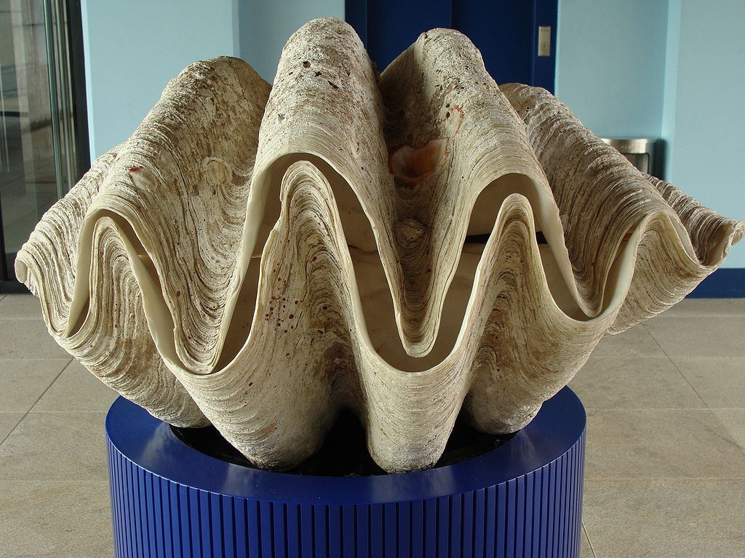
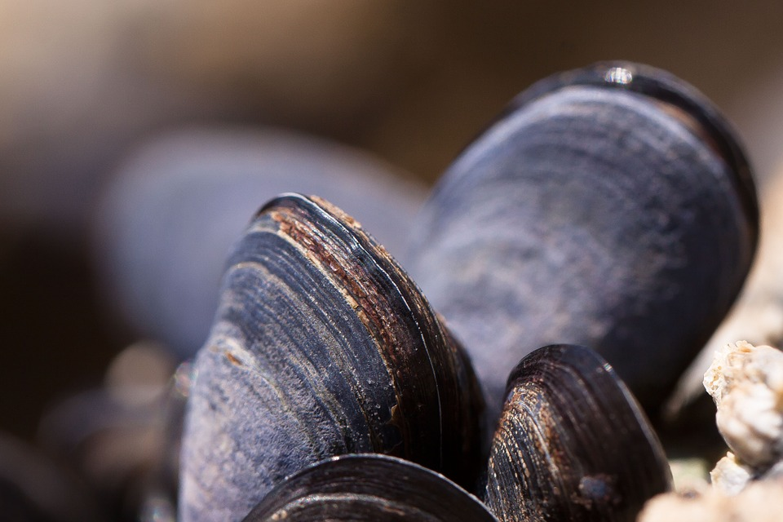
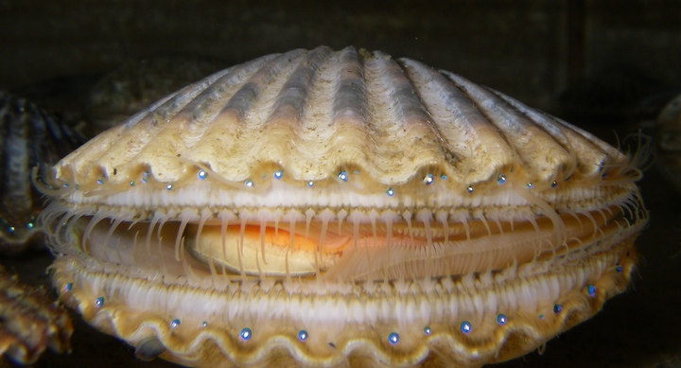
Bivalves
The dataset focuses only on bivalves, mollusks with two shells.
Inside their shells, bivalves are soft-bodied.
They absorb oxygen from the water through gills
Notes:
(Ask students what else they know about bivalves and if they know of any other types of organisms that are bivalves. Common ones include cockles, oysters, scallops, clams, and mussels.)

Slide 7
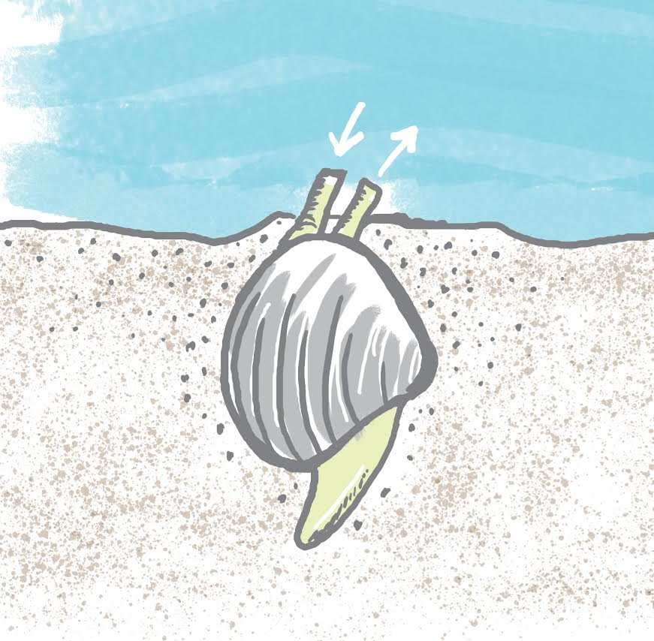
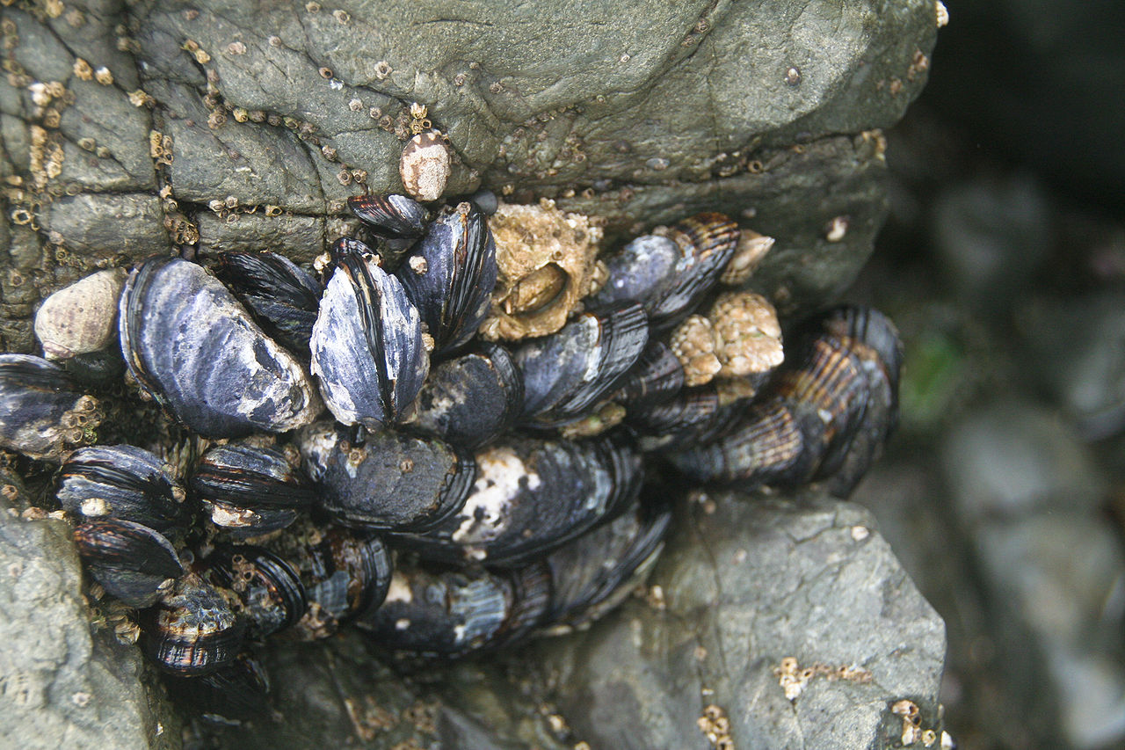
Where do bivalves live?
Infaunal bivalves live in underwater sediments
Epifaunal bivalves live on surfaces under the water
Notes:
The images here show an infaunal clam and epifaunal mussels.

Slide 8
How do bivalves eat?
Suspension/filter feeding using gills
Deposit feeding (swallowing mud)
Chemosynthesis
Carnivory
Notes:
Suspension feeders take in water and strain plankton out through their gills. This is illustrated here, showing how an infaunal clam uses a siphon to take in water for filter feeding and another to expel the water. Deposit feeders swallow mud and absorb the organic matter (excreting the indigestible substances). Some do this from within the mud itself, and others slurp sediments from the surface of the ocean bottom. Chemosynthetic feeders have symbiotic bacteria in their gills that convert inorganic compounds in the sediment into organic compounds that the mollusk can use for energy. Carnivorous feeders catch and eat other animals. Carnivorous bivalves spread sticky threads on the seafloor to trap prey or use suction to pull prey into their shells for digestion.

Slide 9
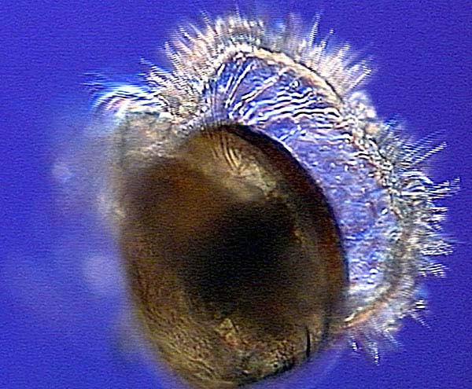
How do bivalves disperse?
Most bivalves can’t move much as adults.
But their larvae can travel far in the ocean currents, allowing some bivalves to have large geographic ranges.
Notes:
Most bivalves cannot move far once they are adults. They are attached to the rock or buried in the sediment. But their larvae can travel far in the ocean currents, with a special structure (shown here) bearing cilia that keep them afloat and allow them to filter food from the water.

Slide 10
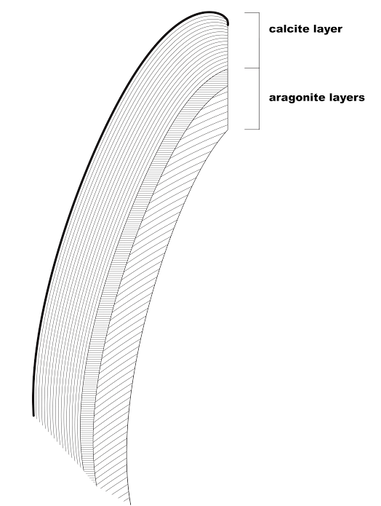
What are bivalve shells made of?
Layers of calcium carbonate (CaCO3)
Calcite: more stable
Aragonite: less stable
Aragonite may incorporate organic material, which makes it a little more stable
Notes:
Many mollusk shells are made of several layers, and different species build these layers out of two different materials: aragonite and calcite. Both aragonite and calcite are forms of calcium carbonate (CaCO₃), but calcite is chemically more durable/stable. Some mollusks have shells made just out of calcite, some have shells made with outer layers of calcite and an inner layer of aragonite, and some have shells made of just aragonite. To further complicate matters, the aragonite that makes up these shells may be rich in organic material or it may have very little. The image here shows a cross section of a scallop shell, which has an outer layer of calcite and an inner layer of aragonite.

Slide 11
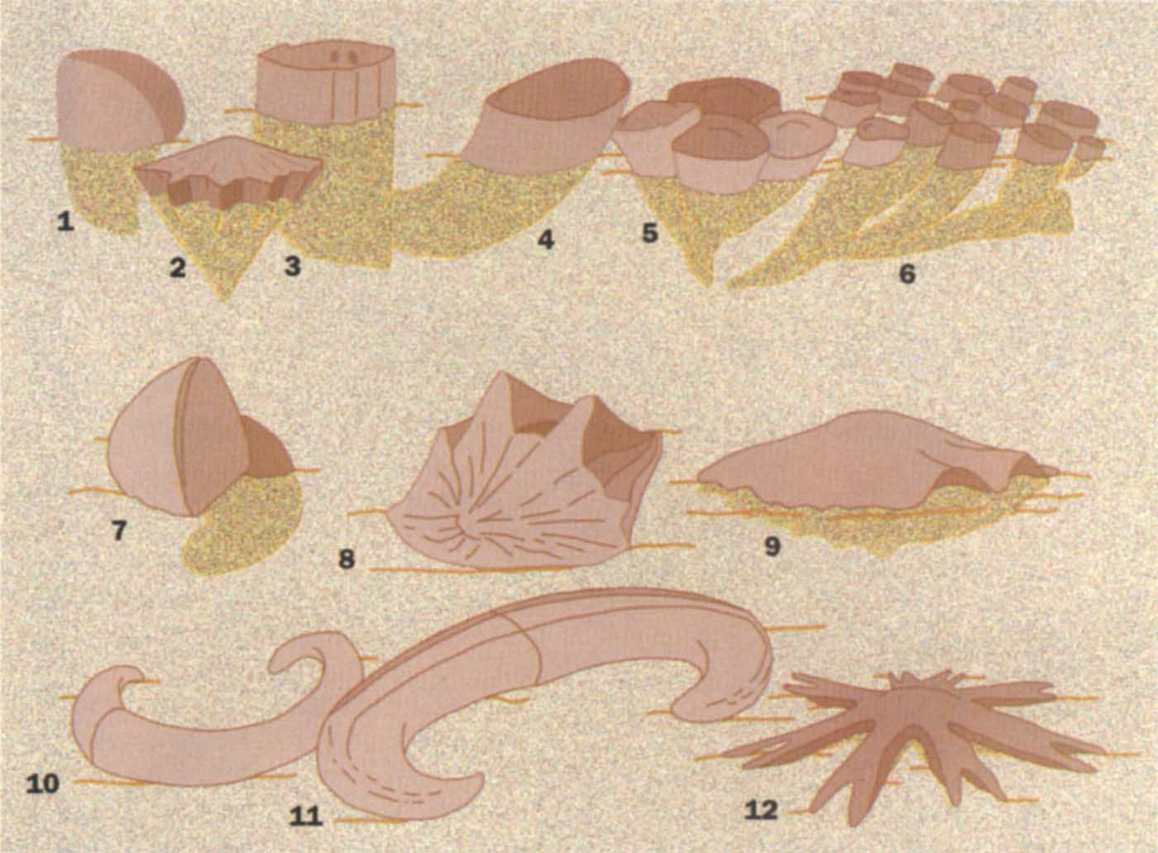
The rudists: Mysterious, extinct, tropical bivalves
Notes:
Rudists were spectacular, extinct bivalves of tropical Cretaceous seas. Some were 2 meters long! They went extinct at the end of the Cretaceous just like the dinosaurs.

Slide 12
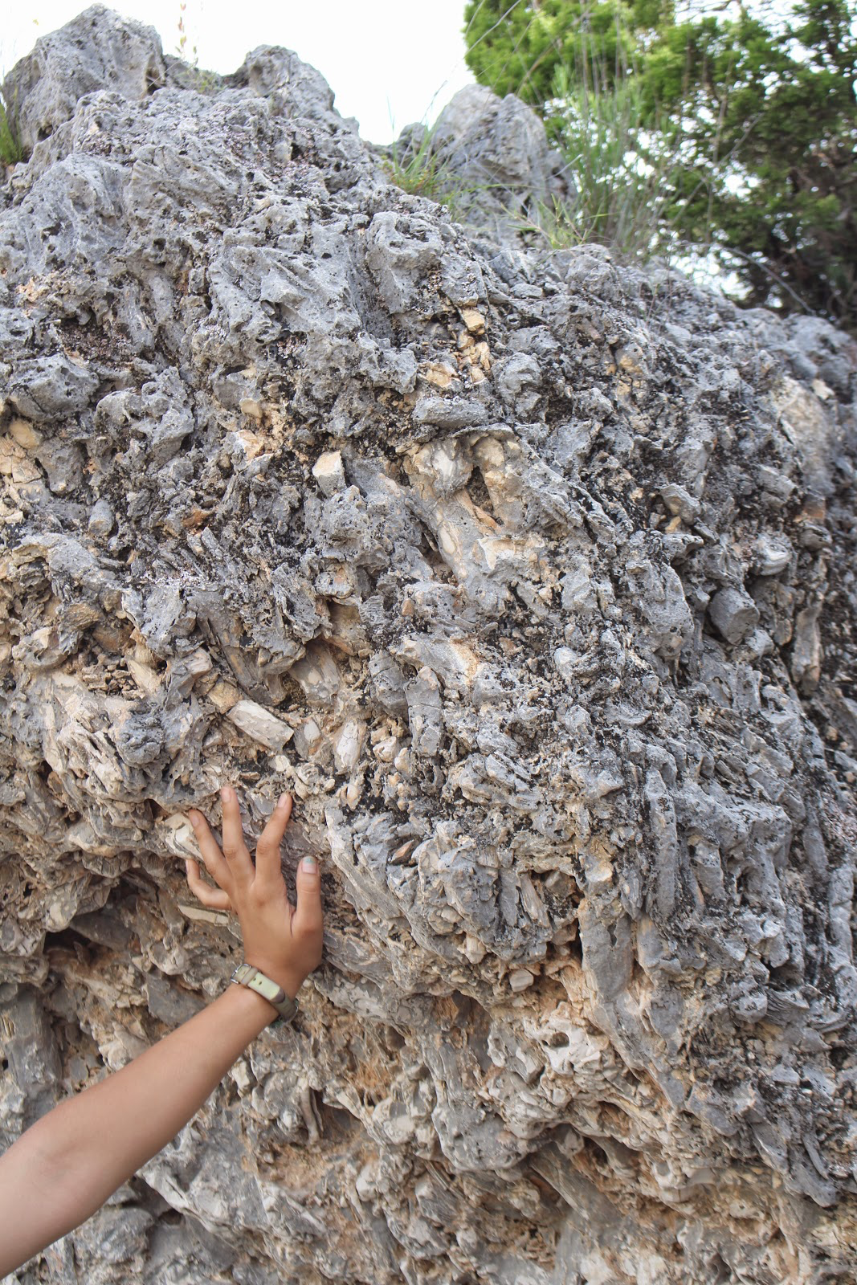
The rudists: Mysterious, extinct, tropical bivalves
Notes:
They formed dense reefs in shallow tropical water. Scientists aren’t yet sure whether they were suspension-feeders or harbored symbiotic algae (like reef corals today). This fossil rudist reef is located in Texas.

Slide 13
Introduction to bivalve extinction data set

Slide 14
Bivalve Extinction Dataset
Bivalve relationships
Order
Family
Genus
Victim/survivor
Geographic distribution
Geographic range
Number of provinces occupied
Polar/temperate/tropical/widespread
Shell type
Aragonite only
Calcite/low-organic matter aragonite/high-organic matter aragonite
Resistance to ocean acidification
Lifestyle
Infaunal/epifaunal
Feeding type
Age of fossils
Oldest
Youngest
Data from: Krug, A. Z., Jablonski, D. (2012). Long-term origination rates are reset only at mass extinctions. Geology. 40:731-734.
Notes:
Scientists have studied bivalve fossils from throughout Earth’s history. The data set that you’ll be working with is based on fossils from bivalve genera that were alive during the K-T mass extinction. The data set includes a variety of information about each genus.
(Briefly discuss each of these variables in the data set. Full descriptions are included in the Teacher background information document. The next slide includes a map to clarify the Geographic distribution and Geographic range variables.)
In this activity we’ll be “exploring” these data using simple statistical an graphing tools in order to investigate what factors influence extinction risk. In the “data exploration” phase of analyses, scientists start to look at the data and understand the patterns within it. What they find during data exploration will help them to decide on the most appropriate statistical tests.
You will generate your own hypotheses concerning how and why these traits might influence risk extinction, and use simple plots to investigate whether your hypotheses are supported.

Slide 15
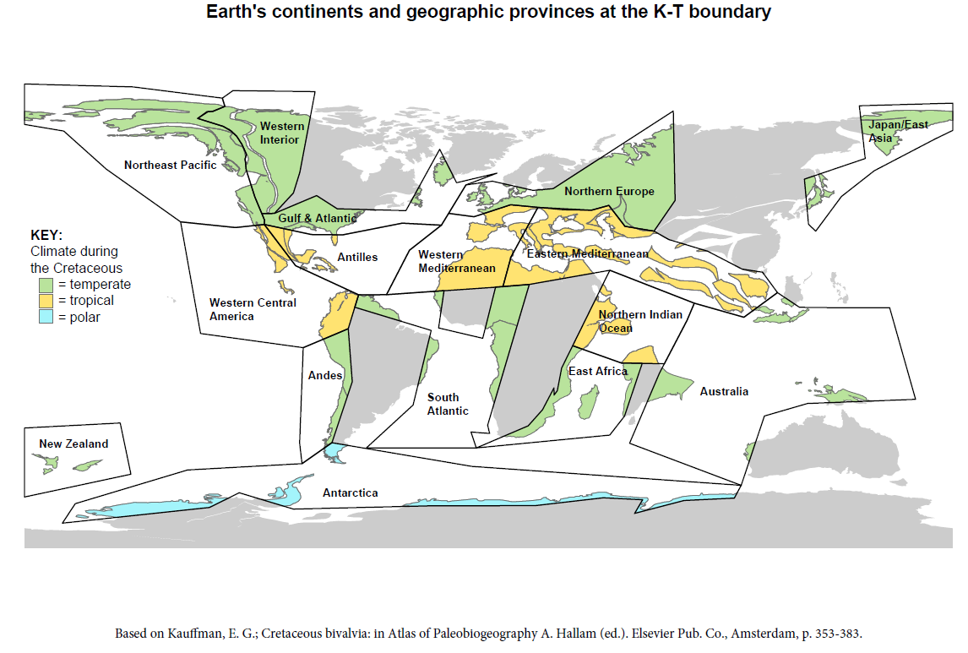
Notes:
This map shows the location of Earth’s continents at the time of the K-T extinction. Notice that India is still an island! Your data set includes information about the provinces that the bivalve fossils were found in.

Slide 16
Slides for wrap-up discussion

Slide 17
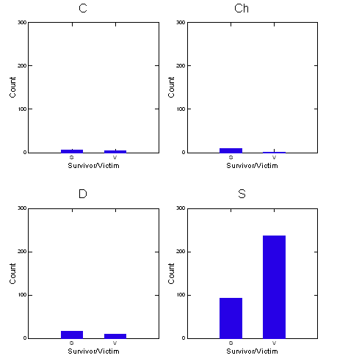
Feeding type
Count
S V
Survivor/Victim
S V
Survivor/Victim
Count
S V
Survivor/Victim
S V
Survivor/Victim

Slide 18
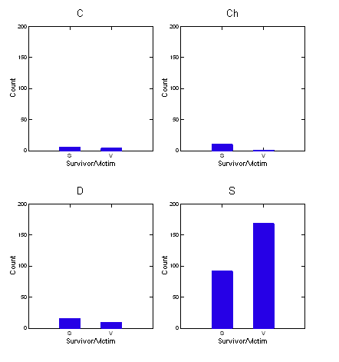
Feeding type without rudists
Count
S V
Survivor/Victim
S V
Survivor/Victim
Count
S V
Survivor/Victim
S V
Survivor/Victim

Slide 19
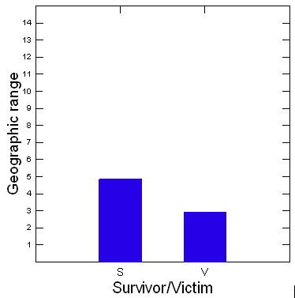
Geographic range
Percent of genera surviving
Geographic range
S V
Survivor/Victim
Number of provinces occupied

Slide 20
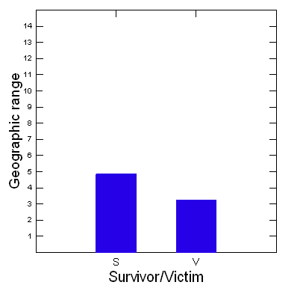
Geographic range without rudists
Percent of genera surviving
Geographic range
S V
Survivor/Victim
Number of provinces occupied

Slide 21
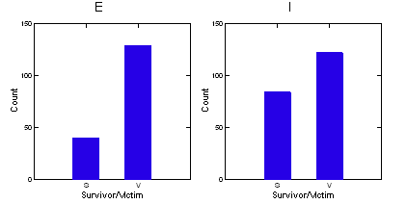
Infaunal/epifaunal

Slide 22
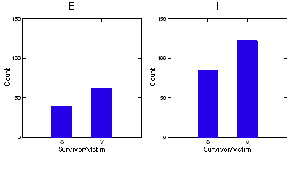
Infaunal/epifaunal without rudists

Slide 23
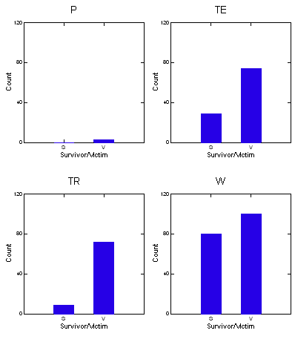
Climate type
Count
S V
Survivor/Victim
S V
Survivor/Victim
Count
S V
Survivor/Victim
S V
Survivor/Victim

Slide 24
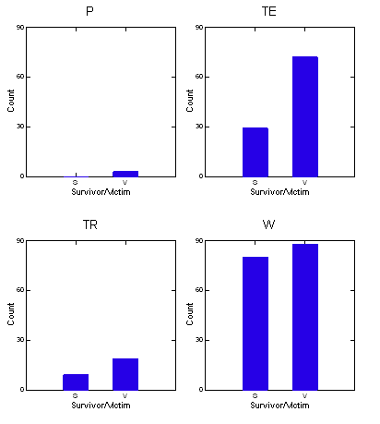
Climate type without rudists
Count
S V
Survivor/Victim
S V
Survivor/Victim
Count
S V
Survivor/Victim
S V
Survivor/Victim

Slide 25
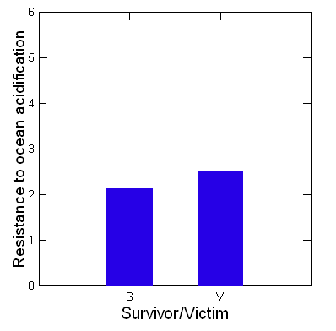
Shell structure

Slide 26
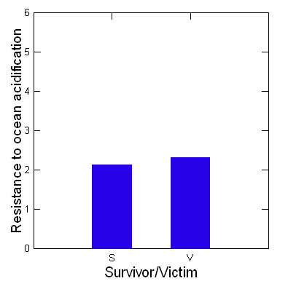
Shell structure without rudists

Slide 27
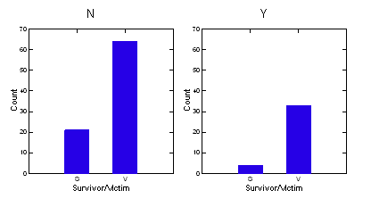
Proximity to impact

Slide 28
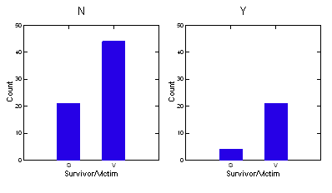
Proximity to impact without rudists

Slide 29
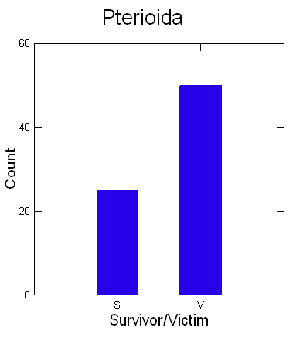
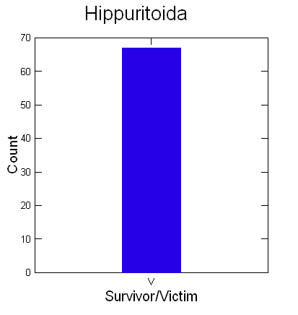
Effect of relatedness

Slide 30
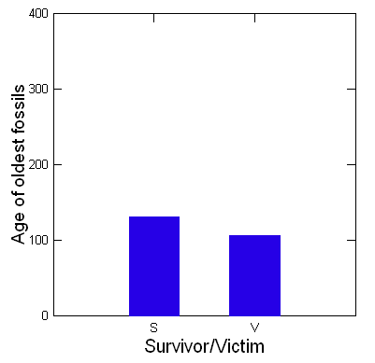
Age of genus

Slide 31
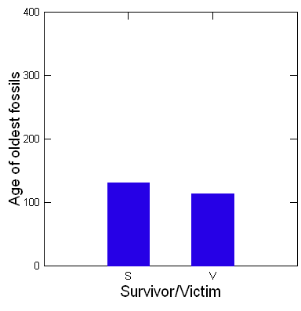
Age of genus without rudists

Slide 32
Credits for bivalve images
Tridacna gigas by Drow Male is licensed under CC International 4.0
California mussels by Sharon Mollerus is licensed under CC 2.0 Generic
Bivalve larva photo from NOAA, http://oceanexplorer.noaa.gov/explorations/02mexico/background/mussels/media/bivalve_veliger.html
Rudist reconstructions from Jablonski, D. 1996. The rudists re-examined. Nature 383: 669-670
Rudist reef photo reproduced with permission of Dr Rowan Martindale from http://findingfossils.blogspot.com/2015/05/austin-reefs.html

